Slide 1

SAVEETHA INSTITUTE OF MEDICAL AND TECHNICAL SCIENCE
CHENNAI - 602105
AI-Based Genetic Disorder Risk Prediction and Classification
Guide: VEERAMANI R
Presented by:
SARVAJITH S,

Slide 2
OVERVIEW
OVERVIEW
Abstract
Introduction
Objective
Literature Survey
Problem Statement
Methodology
System Architecture
Modules
Implementation
Results
Conclusion
Future Enhancement
References

Slide 3
ABSTRACT
GeneGuard is an AI-based system for predicting the risk of genetic disorders.
It analyzes selected genetic and patient-related features.
Machine Learning is used to classify the user into different risk levels.
Explainable AI helps users understand why a particular risk prediction was made.
The system provides counseling-oriented recommendations based on the predicted risk.
Genetic and personal information is handled with privacy and security considerations.
GeneGuard is a decision-support system and not a medical diagnosis tool.

Slide 4
INTRODUCTION
Genetic disorders are diseases caused by changes or abnormalities in genes or chromosomes.
Early risk prediction can help identify individuals who may require further medical evaluation.
Artificial Intelligence (AI) can analyze healthcare and genetic data to identify patterns related to disease risk.
Explainable AI (XAI) helps users understand the important factors behind an AI-generated prediction.
GeneGuard combines AI-based risk prediction with explainable results and counseling support.
The system also focuses on privacy and security because genetic and personal data are highly sensitive.

Slide 5
OBJECTIVE
To develop an AI-based genetic disorder risk prediction system.
To classify users into suitable risk categories.
To provide understandable explanations for AI predictions.
To provide counseling-oriented recommendations.
To protect sensitive genetic and personal information.
To support healthcare professionals in decision-making.

Slide 6
LITERATURE SURVEY
Author(s) | Title | Year | Methodology | Key Findings
V. Chen et al. | Interpretable Machine Learning in Computational Biology | 2024 | Explainable ML | Improves interpretability of biological data.
A. S. Alharthi et al. | Explainable AI in Human Health Monitoring | 2024 | XAI & Healthcare | Improves transparency in health prediction.
Q. Sun et al. | Explainable AI for Medical Applications | 2024 | XAI & Medical AI | Supports trustworthy medical predictions.
R. Alkhanbouli et al. | Explainable AI in Disease Prediction | 2025 | XAI & ML | SHAP and LIME improve prediction interpretation.
C. Wang et al. | Deep Learning and Explainable AI for Genetic Insights | 2025 | Deep Learning & XAI | Provides interpretable insights from genetic data.

Slide 7
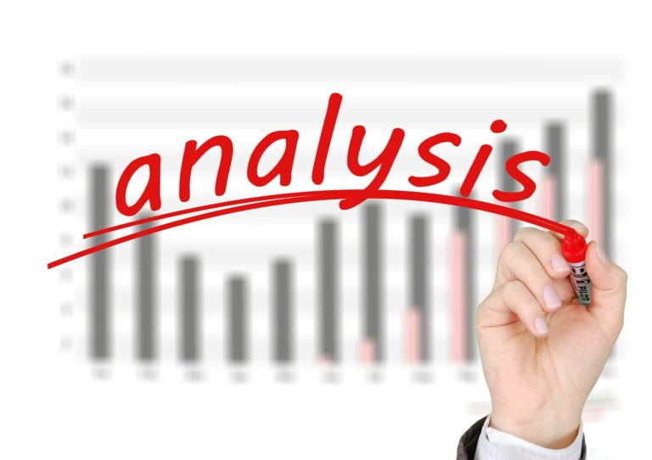
PROBLEM STATEMENT :
Genetic disorder risk assessment can involve complex information.
Users may not understand how risk predictions are generated.
Black-box AI models can reduce trust.
Sensitive genetic information requires strong privacy protection.
Existing systems may not provide personalized counseling support.
Therefore, an explainable and secure AI-based risk prediction system is needed.

Slide 8
METHODOLOGY
Data Collection
↓
Data Preprocessing
↓
Feature Selection
↓
Model Training
↓
Risk Prediction
↓
Explainable AI
↓
Counseling Recommendation
↓
Secure Report

Slide 9
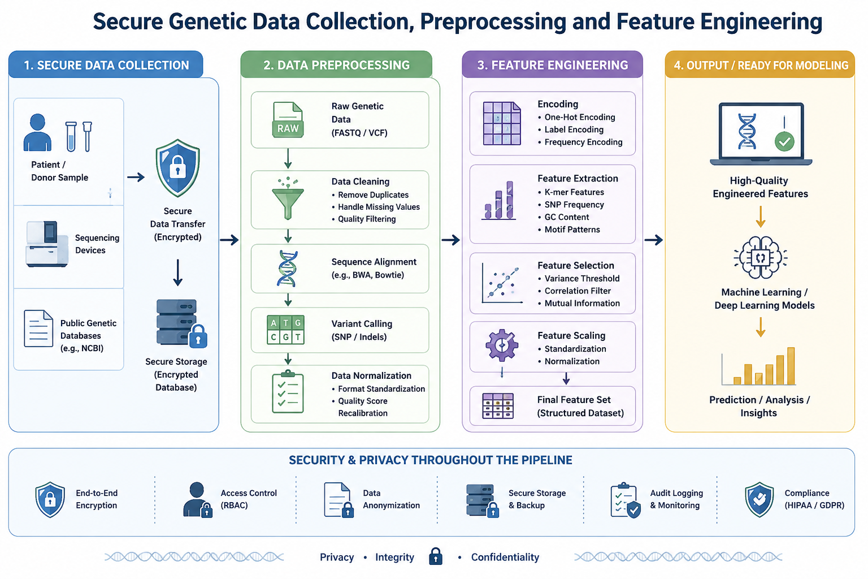
System Architecture
Figure 1 : Secure Genetic Data Collection, Preprocessing and Feature Engineering

Slide 10
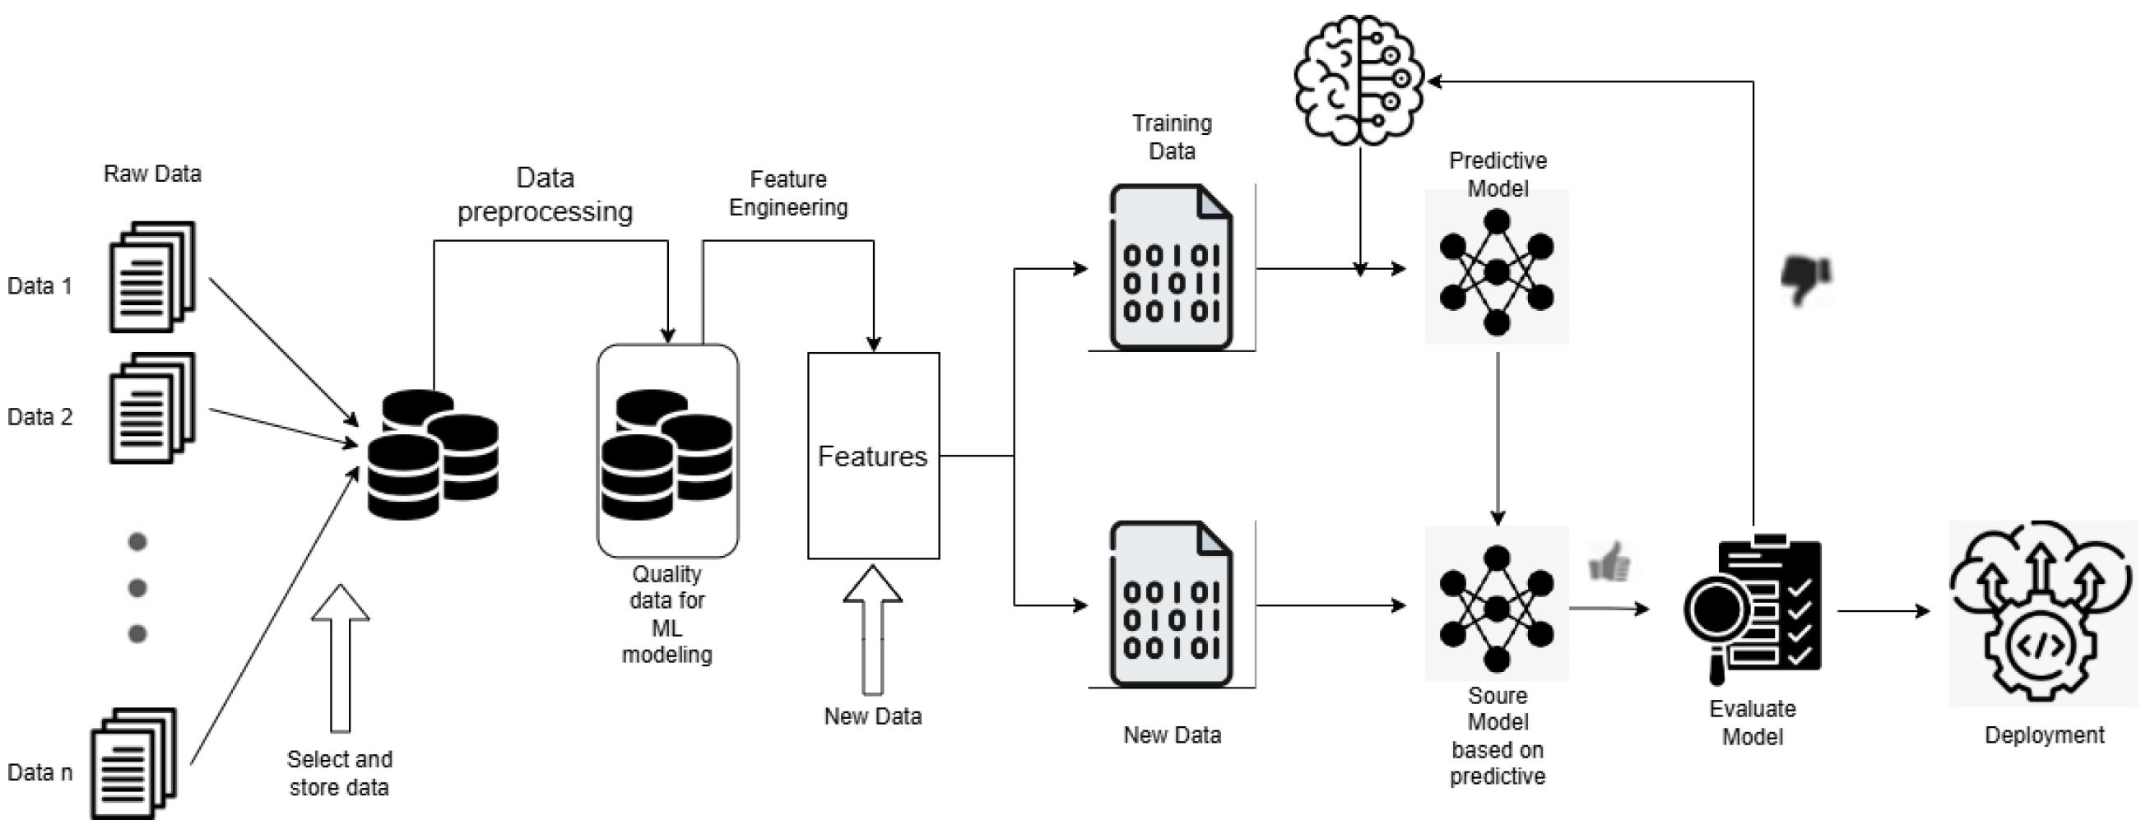
Module 1: Secure Patient Data Module
User registration/login
Secure data input
Patient information management
Authentication
Data protection

Slide 11
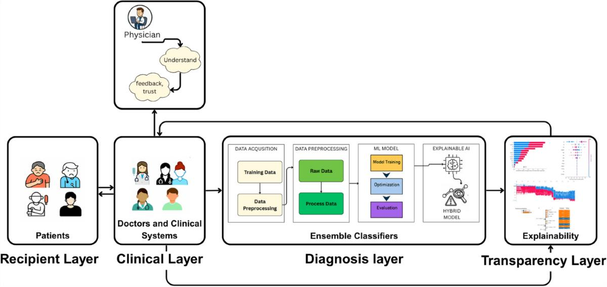
Module 2 – Genetic Risk Prediction Module
Data preprocessing
Feature selection
ML model
Risk classification
Prediction generation

Slide 12
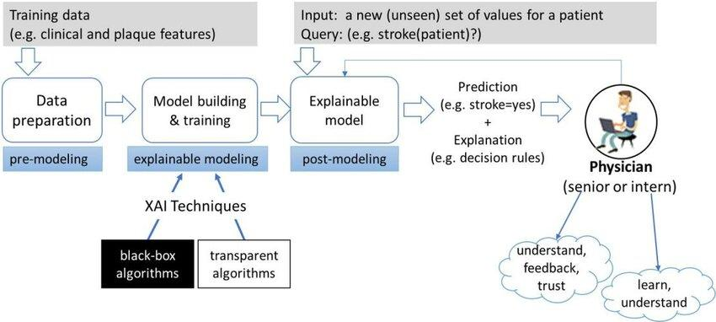
Module 3 – Explainable AI Module
Analyze model prediction
Identify important features
Generate explanations
SHAP/LIME-based interpretation
Display understandable results

Slide 13

Future Enhancement
Component | Technology
Programming | Python
Frontend | HTML, CSS, JavaScript / React
Backend | Flask / FastAPI
Machine Learning | Scikit-learn
Explainable AI | SHAP / LIME
Database | MySQL / SQLite
Security | Authentication + Encryption

Slide 14
CONCLUSION
GeneGuard provides AI-assisted genetic disorder risk prediction.
It converts complex data into understandable risk information.
Explainable AI improves transparency and user trust.
Counseling support helps users understand the next appropriate steps.
Security mechanisms help protect sensitive information.
The system supports professionals rather than replacing medical diagnosis.

Slide 15
REFERENCES :
World Health Organization – Genetic Diseases and Genomics resources.
Scikit-learn Documentation – Machine Learning.
SHAP Documentation – Explainable AI.
LIME – Local Interpretable Model-Agnostic Explanations.
Research papers on Explainable AI in healthcare.
Research papers on machine learning for genetic disorder prediction.

Slide 16


